Slide 1
PRESENTS
JOSHUA PROJECT 2000
A Presentation to Denominational Leaders Sponsored by
ACMC
Chicago, April 9, 1996

Slide 2

AD 2000 Initiatives
Organizational
Denominational Plans
Christian Organizations
AD2000 Partnerships
Local Church
Conferences
Geographical
Countrywide
Continentwide
Local cooperative
Regional in country
Functional
Task Forces
Resource Networks
Prayer & Partnership

Slide 3
AD2000 Denominational Summit
Declaration, Dec. 1993
Having experienced the unity of the multifaceted body of Christ &
the unique corporate gifting that different denominations and organizations bring to that body
We, the attendees of this historic summit meeting,

Slide 4
AD2000 Denominational Summit
Declaration, Dec. 1993
We, the attendees of this historic summit meeting,
Now, being of one mind in our commitment to work together for the evangelization of the world by the year 2000 and beyond, we, …
declare our joint commitment to seek a church for every people and the gospel for every person by the year 2000.
We urgently call the worldwide Body of Christ to join openly in linking hands, hearts, minds and spirits in this grand cause of Jesus Christ.

Slide 5
AD2000 Denominational Summit
Declaration, Dec. 1993
We, the attendees of this historic summit meeting,
1. To magnify the focus on the ... 10/40 Window…
2. To … participate in prayer initiatives...
3. To encourage our churches to participate in the national strategy initiatives.
4. To seek ways to accelerate the mission thrust of our respective denominations in our work around the world and the recruitment of new missionaries
5. To utilize the various networks and task forces of the AD 2000 Movement.

Slide 6
AD2000 Denominational Summit
signed by ...
Michael Green, Anglican Church
Geremias Do Couto, Assemblies of God, Brazil
Bob Fulton, Association of Vineyard Churches
Peter Nanfelt, Christian & Missionary Alliance
Grant McClung, Church of God
Roland Vaughan, Church of God
Lamar Vest, Church of God
Adrian Varlack, Church of God of Prophecy
Eugene Stowe, Church of the Nazarene

Slide 7
AD2000 Denominational Summit
signed by ...
Robert Scott, Church of the Nazarene
Hans Finzel, CBI
Panya Baba, Evangelical Church of West Africa
Paul Larsen, Evangelical Covenant Church
Paul Cedar, Evangelical Free Church of America
Jim Forstrum, Evangelical Free Church of America
Lewis Myers, Foreign Mission Society, SBC
Avery Willis, Foreign Mission Society, SBC
John Amstutz, Four Square Missions

Slide 8
Mission America
OUR MINISTRY STRATEGY
1. CITIES/COMMUNITIES: … ministry initiatives will take place in virtually every city and community in US in next 5 years.
2. MINISTRY NETWORKS: ... enable the formation and implementation of scores of ministry networks ...
3. STRATEGIC INITIATIVES: ... invite every church and Christian in America ...

Slide 9
Mission America
OUR SERVANT MINISTRY
1. CATALYZATION: ... encouraging denominations, ministry networks, local churches and Christian ministries to team together in prayerfully reaching out to America.
2. COMMUNICATION: ... attempting to communicate all that God is doing in our nation.
3. COLLABORATION: ... enabling collaborative ministries

Slide 10
A church for every people
and the gospel for every person
by AD2000
NATIONAL
INITIATIVES
Countrywide
JOSHUA
PROJECT 2000
A Global Initative
Prayer
AD 2000 & Beyond Movement Five Year Plan

Slide 11
Joshua Project 2000
A call to
partner to reach the unreached

Slide 12

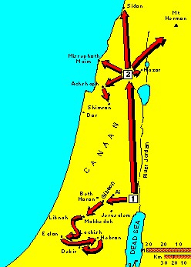
Joshua
Get ready to cross, 1:2
I will give you every place, 1:3
Be strong and courageous, 1:6
Get your supplies ready, 1:11
Go, look over the land, 2:1
Consecrate yourselves, for, 3:5
These stones ... a memorial, 4:7
March around the city, 6:3
Shout, the wall collapsed, 6:20
Present tribe by tribe, 7:14
Each to own inheritance, 24:28

Slide 13
WHAT DOES IT MEAN?
... a global cooperative strategy,
focused on the least evangelized peoples
that seeks to engage every church, agency, denomination & Christian
from every country in the world
in an effort to implement the goal ...

Slide 14
A church for every people and the gospel for every person by AD2000

Slide 15
What is the Goal?
Make a priority of establishing, as a minimum
a pioneer church planting movement
within every strategic ethno-linguistic people
within every country of the world
by December 31, 2000

Slide 16
Assumptions
Mandate with a Promise
The Modelling of Jesus
The Magnificent Acceleration
The Merged List

Slide 17
The 2000 Least Evangelized Peoples

Slide 18
The Joshua Project 2000 List
The listing represents
the frontier of missions today,
and we will do everything we can
to support you in this endeavor.
Jerry Rankin, President,
Foreign Mission Board, SBC

Slide 19
How Can This Goal Be Accomplished?
Countrywide Initiatives

Slide 20
Mission America OUR
COMMITMENT TO WORLD EVANGELIZATION
We believe that no solitary Christian, church, denomination, mission agency or organization can hope to complete the task of world evangelization alone. We need one another.
For the first time in history, Christians from virtually every continent and country have begun to work together in a great global advance of the gospel.
Paul Cedar & Bill Waldrop

Slide 21
Mission America OUR
COMMITMENT TO WORLD EVANGELIZATION
Mission America is collaborating with Christians in some 100 other nations of the world to launch Joshua Project 2000--a five-year initiative to help establish church planting movements in strategic places around the world.
Paul Cedar & Bill Waldrop

Slide 22
How Can This Goal Be Accomplished?
Task Forces & Networks
Countrywide Initiatives

Slide 23
Assessment Task Force
Purpose
... seeks to work with Christian leaders of all denominations and organizations to
1) monitor, 2) analyze, and 3) evaluate the status of global evangelization for strategic planning and data-based decision making to facilitate the continuous multiplication of indigenous churches among the selected peoples of the Joshua Project 2000.

Slide 24
Global Evangelization Model
Movement from one level to another
Little or no access to gospel
No viable indigenous church
The majority of its members have never heard the gospel
The majority of its members have heard the gospel
Majority of its members have made a personal profession

Slide 25
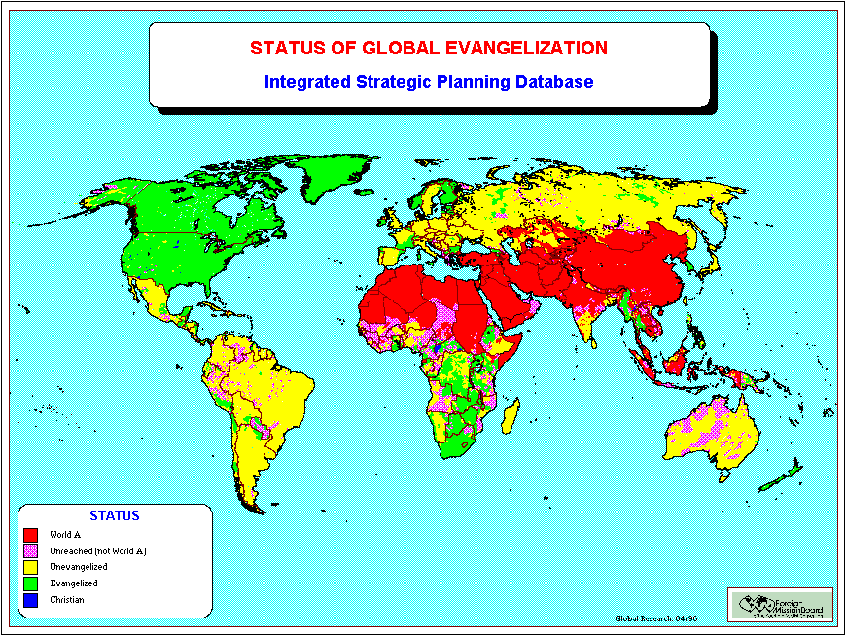

Little or no access to gospel
No viable indigenous church
Unevangelized (majority not heard)
Evangelized(majority have heard)
Christian (majority believers)

Slide 26
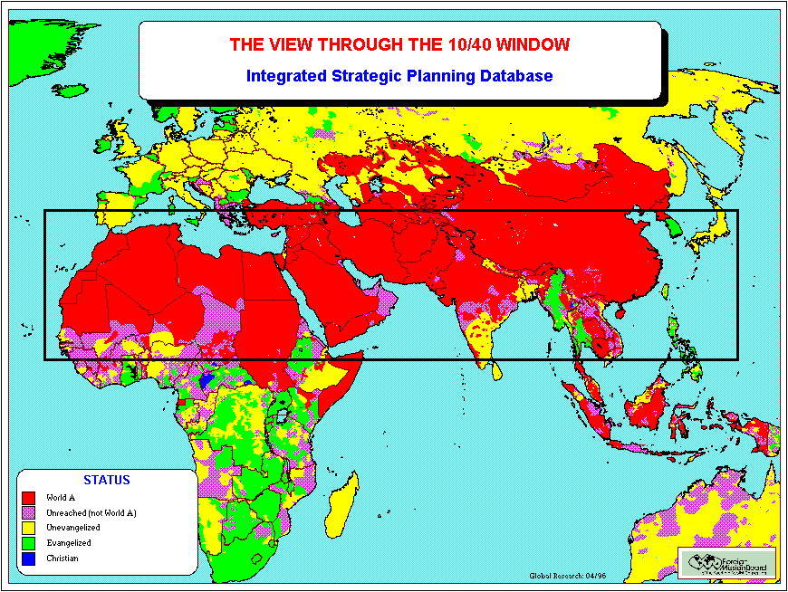
Little or no access to gospel
No viable indigenous church
Unevangelized (maj. not heard)
Evangelized(maj. have heard)
Christian (majority believers)

Slide 27
Strategy and Resource Development
Task Force Purpose
... designed to provide leaders with the necessary tools to participate effectively in Joshua Project 2000 by enabling them to develop their skills to:
cooperate
partner
evaluate
plan strategically
manage resources
lead and enable others.

Slide 28
How Can This Goal Be Accomplished?
Mission Agencies
Task Forces & Networks
Countrywide Initiatives

Slide 29
EFMA Board Resolution
September 1995
MOTION PREVAILED that EFMA takes a position to embrace the concept of placing a team of church planters in every one of the 2000 unreached people groups of 10,000 or more individuals with this being done by the year 2000.

Slide 30
EFMA Board Resolution
September 1995
In the remaining five years of the millennium we will work diligently to penetrate these people groups with church planting efforts. In this cause we will be joining with hundreds and perhaps, thousands of churches and mission agencies from around the world.

Slide 31
EFMA Board Resolution
September 1995
Therefore, we encourage our members to coordinate with the AD 2000 & Beyond office in Colorado Springs, Colorado, so as to create synergy with others of like mind and avoid overlap and duplication.

Slide 32
How Can This Goal Be Accomplished?
Denominational Plans
Mission Agencies
Task Forces & Networks
Countrywide Initiatives

Slide 33
AD2000 Denominational Summit
Declaration, Dec. 1993
We, the attendees of this historic summit meeting,
… declare our joint commitment
to seek a church for every
people and the gospel for
every person by the year 2000.

Slide 34
Steps to Reach the Unreached
Profile a people
Pray for a people
Promote a people
Pioneer among a people
Partner for a people

Slide 35
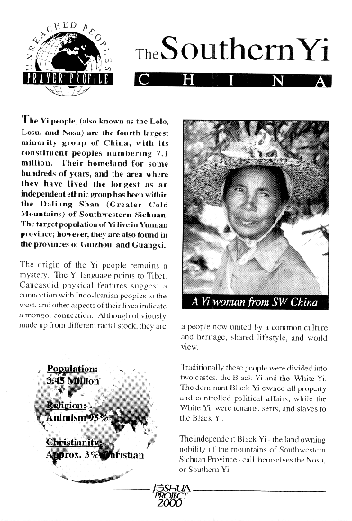
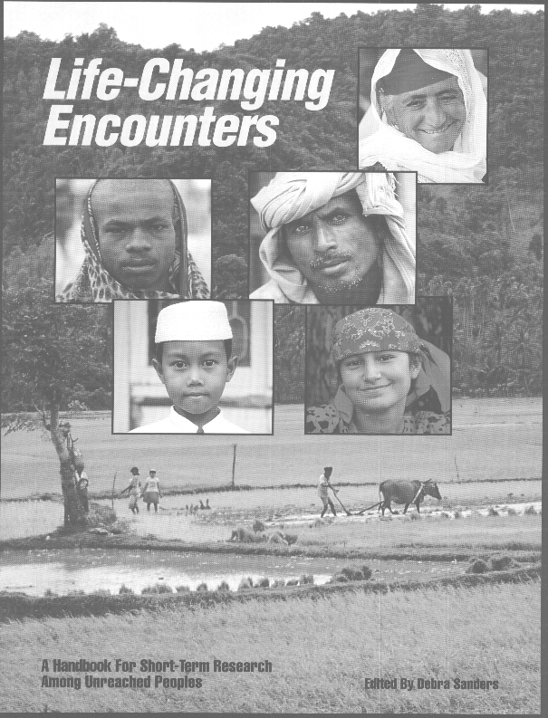
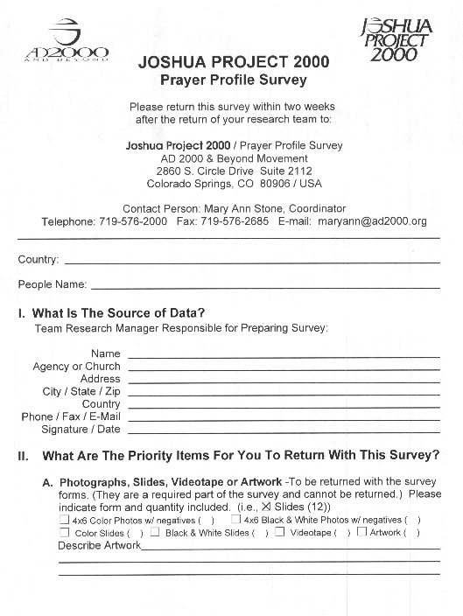
Profile a People
Training Manual

Slide 36
Status of Research Effort
April 5, ‘96
Since 11/95 197 of the 1850 researched
Of those, 30 are fully complete
588 additional peoples assigned
Photographs of 444 acquired
Maps for 100 peoples
1850 with mini-profiles on WWW
100 of the mini-profiles have links to more detailed people profiles

Slide 37
The Joshua Project 2000
Research Effort
The most ambitious global research project ever to be conceived
Ralph Winter, USCWM

Slide 38
Status of Church Planting Effort
April 5, ‘96
132 people sent in information about existing church planting efforts among 104 different JP2000 peoples
848 of the 1850 JP2000 peoples may already have missionaries on site

Slide 39

Denominational Leaders
What will your
contribution be?

